Slide 1

Web Application Development
COMP-229

Slide 2
Web Application Development
Installing Visual Studio Code

Slide 3
Visual Studio Code
To get started, you need an editor or an IDE to work with JavaScript
For a developer, choosing a code editor is a personal choice.
And, there are many choices, like Sublime Text, Atom, Webstorm, or even a simple text editor like Notepad in Windows.
Some Developers also choose a full-fledged IDE like Microsoft Visual Studio (current version is Visual Studio 2019).
Our recommendation is Visual Studio Code. First, it is free, lightweight, and open source.
The features set is driven by Microsoft which is updated monthly with features and enhancements.

Slide 4
Visual Studio Code (continued)
Visual Studio Code is great for working with JavaScript and TypeScript (which we’ll be using in the second half of the course).
It quickly shows warnings and errors as you type code.
There are easy-to-peek-into definitions for the functions. It also has a good ecosystem and extensions created by developers from around the world.

Slide 5
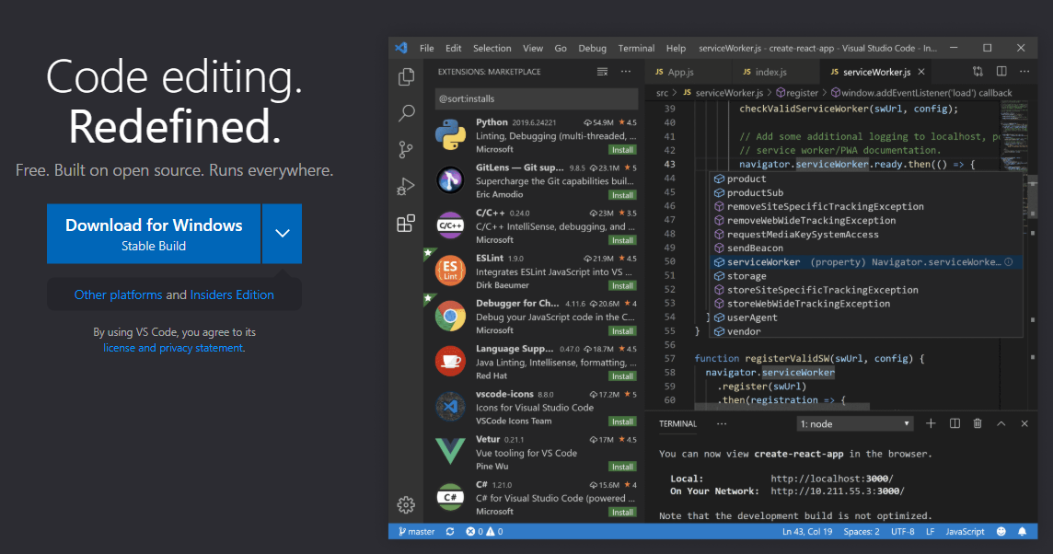
Visual Studio Code (continued)
To install Visual Studio Code, download it from https://code.visualstudio.com

